Slide 1
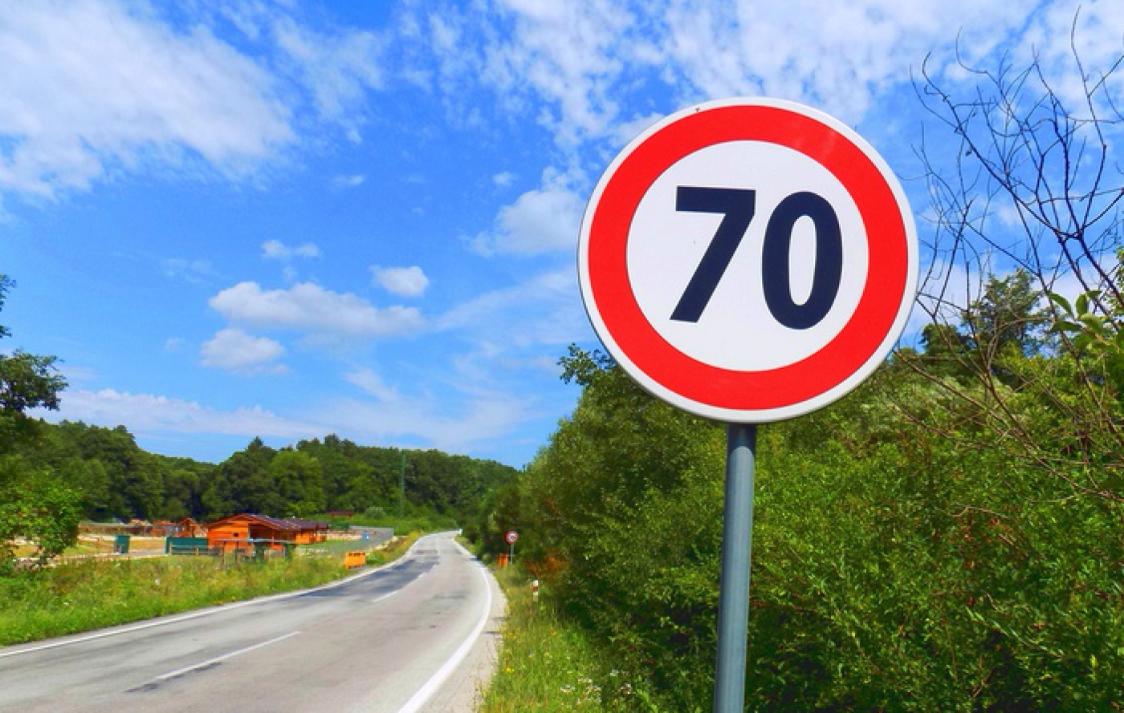
TRAFFIC SIGN RECOGNITION

Slide 2
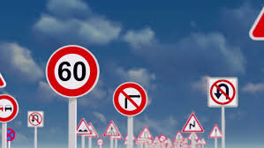
PROBLEM
Recognising traffic sign taken from the dataset of Belgium Traffic Signs .

Slide 3
Why this Project?
Traffic sign recognition has direct real-world applications such as driver assistance and safety, urban scene understanding, automated driving, or even sign monitoring for maintenance. It is a relatively constrained problem in the sense that signs are unique, rigid and intended to be clearly visible for drivers, and have little variability in appearance.

Slide 4
LITERATURE SURVEY:-
RESOURCES:-
Research paper:-
Yann Le Cun’s paper on classification of traffic signs
http://yann.lecun.com/exdb/publis/pdf/sermanet-ijcnn-11.pdf
Deep learning basics with Python, Tensorflow and Keras:-
https://www.youtube.com/watch?v=wQ8BIBpya2k&list=PLQVvvaa0QuDfhTox0AjmQ6tvTgMBZBEXN
Reference Books:-
Pattern Recognition And Machine Learning by Christopher Bishop

Slide 5
SOLUTION
What is new?
Our model is inspired from the traditional method of CNN models. So,we have done some variations in our model to understand the working of CNN.

Slide 6
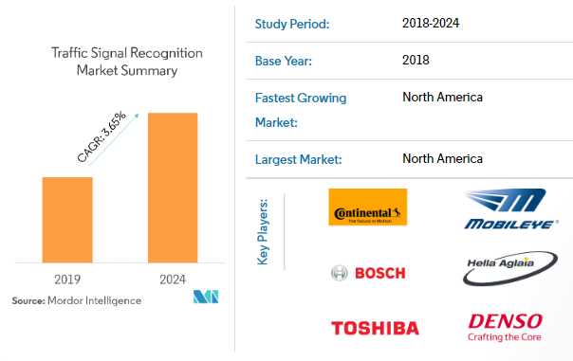
TARGET USER AND MARKET
Drivers
Automobile companies

Slide 7
BLOCK DIAGRAM
LOAD DATA
ANALYZE DATA
DATA PREPROCESSING
MODEL
COMPILE THE MODEL
TRAIN MODEL
MODEL EVALUATION
PREDICTION

Slide 8
CNN INTRODUCTION
Convolutional neural networks have been one of the most influential innovations in the field of computer vision. They have performed a lot better than traditional computer vision and have produced state-of-the-art results. These neural networks have proven to be successful in many different real-life case studies and applications, like;
Image classification, object detection, face recognition.
Self driving cars that leverage CNN based vision systems

Slide 9
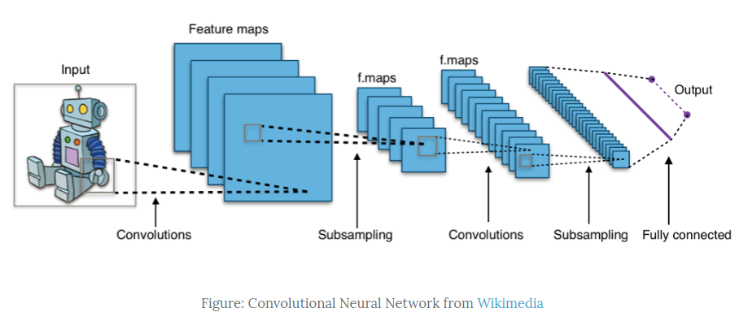
The image shows you that you feed an image as an input to the network, which goes through multiple convolutions, subsampling, a fully connected layer and finally outputs something.

Slide 10
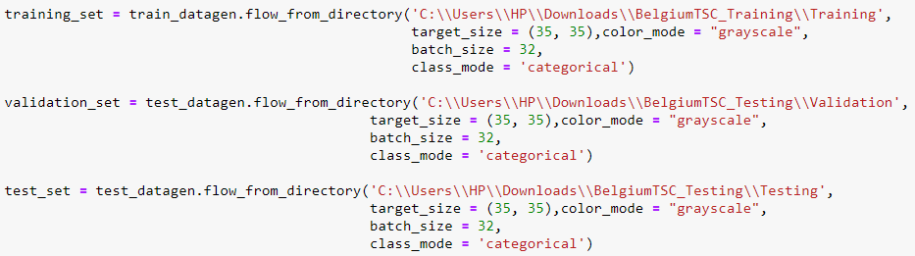
Load data:-
We have downloaded the dataset of Belgium Traffic signs.
Data loading

Slide 11
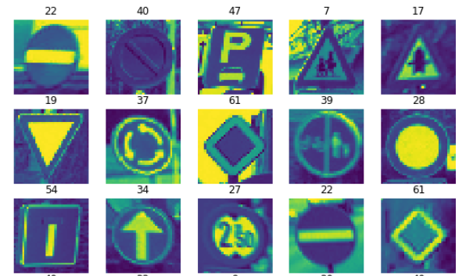
Analyze data:-
Training datasize: 4575 images belonging to 62 classes
Validation datasize: 1277 images belonging to 62 classes
Testing datasize: 1243 images belonging to 62 classes

Slide 12
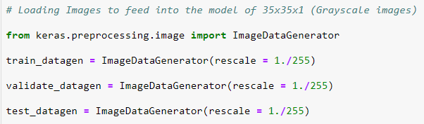
Data preprocessing:-
First of all, we have converted the 'rgb' images into 'grayscale' images while loading.
Then converted all the random size images to
35 x 35 x 1 which is fed into the network.

Slide 13
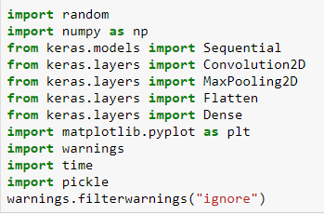
Model:-
First, let's import all the necessary modules required to train the model.

Slide 14
INPUT: 35x35x1
CONVOLUTION: 16-3x3
CONVOLUTION: 32-3x3
MAXPOOLING: 2x2
CONVOLUTION: 32-3x3
CONVOLUTION: 32-3x3
MAXPOOLING: 2x2
FLATTEN
DENSE LAYER : 1000 UNITS
OUTPUT LAYER: 62 CLASSES

Slide 15
Compile the model:-
After the model is created, you compile it using the Adam optimizer, one of the most popular optimization algorithms.

Slide 16
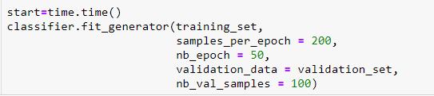
Train the model:-
It's finally time to train the model with Keras fit_generator() function. The model trains for 50 epochs.

Slide 17
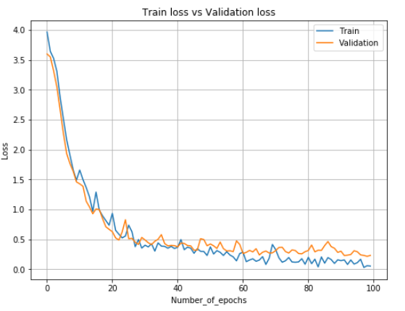
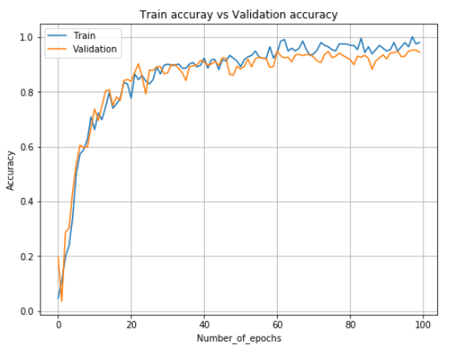
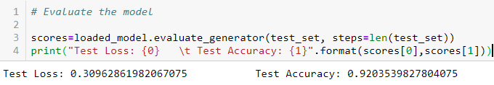
Model evaluation:-

Slide 18
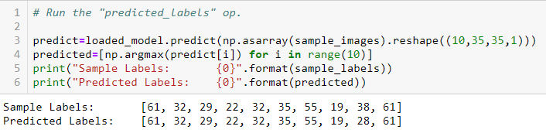
Predictions:-
We use np.argmax() to select the index number which has a higher value in a row.

Slide 19
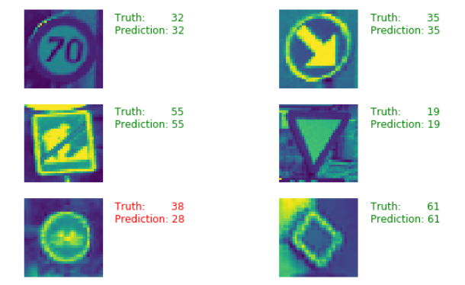
Display visually predicted and ground values:-

Slide 20
FUTURE SCOPE:-
This traffic sign recognition system can be used as an application for modern cars, vehicles and trucks which uses forward facing cameras.
One of the basic use cases of a traffic-sign recognition system is for speed limits.
Companies such as Continental, Bosch, Audi, Google, Delphi, and Mercedes-Benz are working towards enhancing the autonomous driving concept. So, they may use this system as an application.

Slide 21
CONCLUSION:-
By applying ConvNets to the task, traffic sign classification becomes much easier and gives better accuracy of about 90-95%.
Using this recognition system, an application for the driver safety purpose is built.
The application will keep the driver updated about the traffic signs for better driving assistance and safety.
In future the driver assistance system can be used in cars to work according to the traffic signs and the recognition system can be used in self driving cars to learn and understand the traffic signs.

Slide 22
THANK YOU
PRESENTED BY:-
VINEET
VIKRAM
SURINDER

